Slide 1
Greenfield PayCo market entry and case for change in Southeast Asia
August 2018
ePayments Strategy

Slide 2
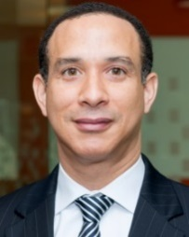









For questions related to this document please contact any one of our team members
Winston Nesfield
Engagement Partner
Singapore winston.nesfield @strategyand.sg.pwc.com
Eduardo Arnoni
Subject Matter Expert
Australia eduardo.arnoni @strategyand.au.pwc.com
Shirish Jain
Engagement Director
Singapore shirish.b.jain @strategyand.sg.pwc.com
Anurag Pandey
Client Relationship Manager
Singapore anurag.pandey @sg.pwc.com
Daryl Mark
Engagement Manager
Singapore
daryl.c.mark @strategyand.sg.pwc.com
Becky Yeoh
Work Stream Lead
Malaysia becky.sk.yeoh @strategyand.my.pwc.com
Xing Juen Goh
Work Stream Lead
Singapore
xingjuen.goh
@strategyand.sg.pwc.com
Jien Yue Choong
Work Stream Lead
Malaysia jien.yue.choong @strategyand.my.pwc.com
Daniel Hoon
Analyst
Singapore daniel.wj.hoon @strategyand.sg.pwc.com
Marc Lam
Analyst
Singapore marc.wx.lam
@strategyand.sg.pwc.com

Slide 3
Project Qualification: ePayments Strategy for a NewCo in South East Asia
Situation | Actions | Results achieved
Clients Government statutory bodies in charge of handling large volume of cash transactions in the country Situation Client required support to establish a NewCo focused on e-payments to advance the nation’s cashless agenda Seeks assistance in devising the company’s value proposition, business and technical architecture, target operating model, investment case, corporate structure, and implementation plan | How Strategy& helped Identified emerging trends in the country’s payments landscape and performed competitor analysis Conceptualised solutions and offerings of NewCo to address current issues in the payments market Developed the high level business model, which includes target customer segments, user journeys and adoption levers Determined the target operating model; identified core functions required for NewCo Assessed joint-venture corporate structure options for NewCo, including legal and board structure Devised the implementation roadmap, including considerations for go-live models, go-to-market strategy, joint-venture partner selection, and stakeholder management Developed case studies of global payment service providers in order to aid decision-making for the Clients | Delivered a high level blueprint to establish an e-payments NewCo Outcome will be presented to one of the key ministries for smart nation and digital in the country

Slide 4
In support of country’s Smart Nation Payments agenda, client aims to establish a NewCo to further drive cashless adoption
Country Payments Target
Clients Objectives
Interoperable system
Simple payments system
Faster settlement speed
Safer transactions
Develop a national ePayment solution through NewCo that aims to:
Promote ePayments for retail and SME transactions
Support the social sector
Establish a forward-looking view (including emerging and key trends) of the payments landscape
Determine the ways-to-play (incl. op model, target markets) for NewCo to accelerate migration to e-payments
Design infrastructure that is future ready by exploring all relevant current and potential technologies – assess suitability of existing national payments infrastructure
Explore opportunities to leverage on existing investments for the collaboration
Higher accessibility and acceptance for customers and businesses
A simplified payments system to increase competitiveness and efficiency for users
Increased speed of settlements via cashless payment methods
A fully regulated payments environment (e.g. establishment of the Payments Council)

Slide 5









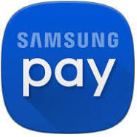



In response to top-down call to action, disruptors are entering the market with two variations of digital wallet propositions
Payment schemes available
2-party scheme
3-party scheme
4-party (or more) scheme
Transaction occurs directly between merchant and customer
Players acquire the consumer & merchant. Acceptance of payment is dependent on a specific application and POS terminal
Players only acquire consumers. Acceptance of payment is widely accepted with Visa and Mastercard POS terminals
Issuer/Acquirer
Issuer
Acquirer
Consumer
Merchant
Consumer
Merchant
Consumer
Merchant
Players:
Players:
Players:
Recently opened to third party developers
Staged wallets
(Stored value)
Pass-through wallets (Secure container)
1
2
Source: Tech in Asia, PwC Strategy& analysis

Slide 6
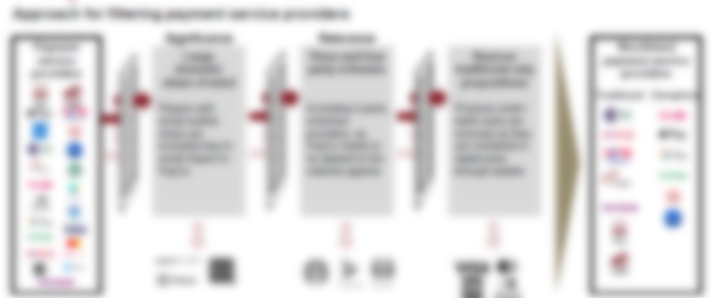

While disruptors brings choice for consumers, ‘Cash’ remains the leading option for low value transactions
Competitor Landscape Analysis
Players were assessed across seven lenses – payment direction, experience, interoperability, settlement speed, cost to merchants, customer reach, and fraud prevention
The payments service providers selected for assessment were filtered based on their significance in the market

Slide 7





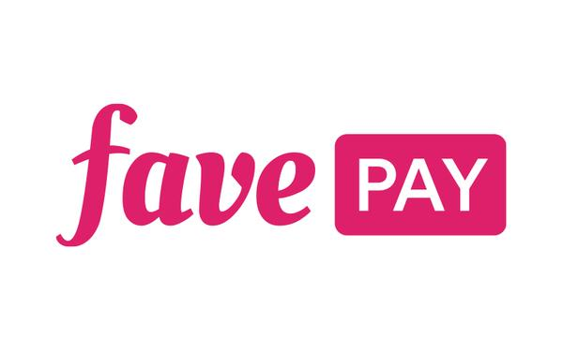

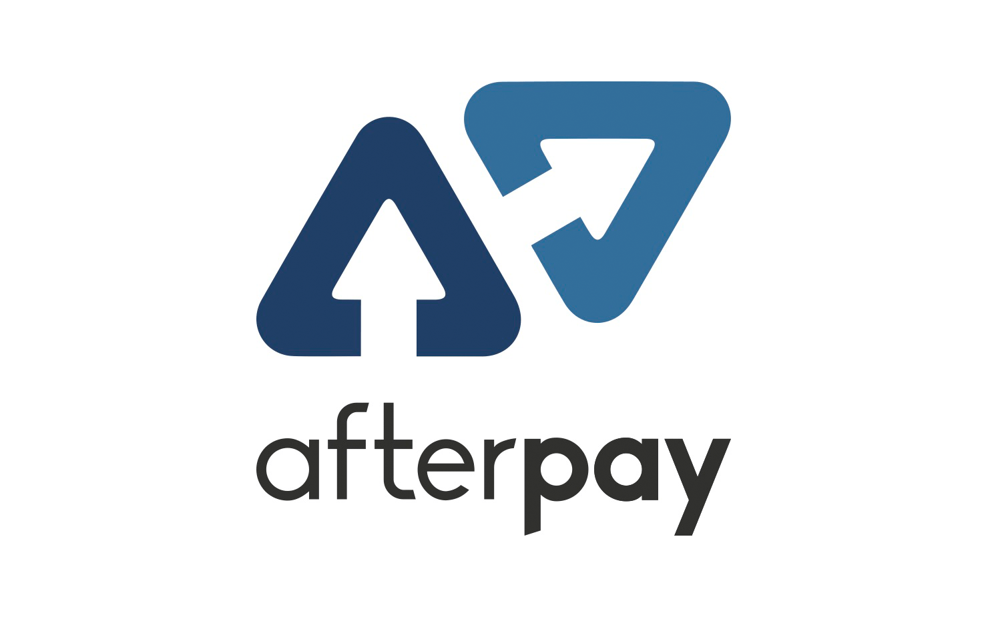

Non-differentiating efforts by players often reap marginal benefits as user pain points remain unaddressed
Differentiating efforts of players
Description
Telco-led mobile wallet
Mobile payment solutions that are available (app-form) to customers upon sign up with a telco company. The mobile wallet allows for C2B and P2P transactions
Key takeaway
Customer experience is compromised as players try to diversify and differentiate themselves
Customers often have to take additional steps to redeem points/benefits (troublesome)
Interoperability is still lacking as payment products are limited to app users and payments are restricted to in-app and pre-approved merchants
Lack of KYC and risk management measures on customers result in defaults and bad debts – business model become unsustainable
Network co-brand cards
Co-branded cards are collaborative efforts by a card network and a retailer to provide additional incentives to customers, usually aimed to drive shared customer loyalty
Disruptive-play
Disruptors enter the payments landscape with intentions to maximise customer wallet-use to support core business. Discounts and incentives are offered frequently to consumers
Razer zVault
Buy-now-pay-later services
Players are providing a buy-now pay-later service that allows customers to make a purchase and pay in instalments, assisting customers with lower cash-in-hand
Reduction in costs to users
Players are expected to reduce MDR in order to remain competitive and encourage merchant adoption (e.g. AMEX have reduced MDR for some merchants to 0.8% per transaction from 4.5%
Amex
Source: Company websites, Guardian, PwC Strategy& analysis

Slide 8







The country’s grassroots still prefer cash especially for low-value transactions – a habit entrenched in hearts and minds
Dominant Payment Mode: A Household’s Perspective
Pioneer (>65 years)
Cash is a norm in every household as it is simple, convenient, instant, and widely accepted
Spends on necessities and miscellaneous items – retail, transit, food
Pays only via cash
Foreign Worker (20 – 44 years)
Spends only when requested by employer, mostly on household necessities
Pays via cash as it is the usual payment mode provided by the employer
Receives wages in cash and remits home to family physically
Yeo Soo Keng, 78
Silver Hair (45 – 65 years)
Maria, 35
Provides for family, spends on household goods and meals
Pays via cash or credit/debit cards
Prefers cash for low-value transactions
Tan Chun Kit, 58
Goh King Kuan, 50
Teen and Young (<19 years)
Young Adult (20 – 44 years)
Spends on meals, transit, and miscellaneous school items
Pays via cash as it is the form of allowance provided by parents
Spends on meals, entertainment, retail, and transit
Pays via cash, cards, e-payments
Open to digital payments, prefers cash for small transactions
Daniel Tan, 26
Marc Tan, 18
Becky Tan, 12
Source: PwC Strategy& analysis

Slide 9

From a small merchant perspective, hawkers prefer cash due to its simplicity and the instant availability of funds
Needs:
Simplicity
Convenience
Availability of Funds
Day-in-life of a Hawker – Overview
Suppliers:
Chun Kit has to go to the market in the morning to get his supplies for the day’s work
His suppliers accepts cash as the only mode of payment
Operations:
Chun Kit’s busiest hours are between 12pm to 2pm. He serves ~90 bowls of fish soup during that period at ~$4 each
A small % of customers asks about e-payments but are happy to pay cash for hawker transactions
Morning
Cash Virtuous Cycle
Mid-day
Tan Chun Kit, 58
Tan Chun Kit, 58 years old, is a hawker selling fish soup. He employs 1 stall assistant and operates between 7.30am – 4.30pm. Cash is his dominant mode of payment.
Chun Kit is the primary breadwinner of his family, which consists of his wife and 2 sons who are still in school. He currently lives in a 3-room flat.
Evening
Family:
After Chun Kit close his stall for the day, he goes to a nearby food centre to pack food for his family – cash is the only accepted payment method in the food centre
Chun Kit’s sons ask him for some money after dinner for a school excursion to the zoo – cash is the most readily available and convenient form of payment for Chun Kit

Slide 10
Example: Cash and ePayments are about cost neutral to hawkers – no compelling incentive to adopt ePayments
ILLUSTRATIVE
Case Study: Cost of Cash vs. ePayments
Scenario 1: Cash Only
1 hour
Cost of Handling Cash
Sales
Reconciliation
Banking
1 hour per day of reconciliation and banking
$10 per hour opportunity cost to Chun Kit¹
365 days of operation per year
Chun Kit only accepts payments by cash – collecting $560 in cash per day for 140 bowls of fish soup
End of day, Chun Kit counts the total cash collected, ensuring it matches to number of bowls sold
Chun Kit goes to the bank to deposit the proceeds for the day, spending a total 1 hour for reconciliation and banking
Opportunity cost per annum: $3,650
Avg. impact to profitability⁴: ~5%
Scenario 2: ePayments Only
20 mins
Cost of ePayments
Sales
Reconciliation
Home
~$200,000 revenue per year²
0.8% – 3.0% fee per transaction³
$20 mins per day at $10 per hour¹
Chun Kit accepts ePayments for all 140 bowls of fish soup everyday, incurring 0.8% - 3.0% transaction fee
End of day, Chun Kit performs bank reconciliation to ensure proceeds received matches bowls sold
Chun Kit goes home and his work is done for the day
Avg. annual trx fee: $4,900
Avg. impact to profitability⁴: ~6%
Note: 1) Hourly opportunity cost is based on average per hour wage adjusted for realisable savings amount of $10; 2) ~$200,000 revenue per year is based on $560 revenue per day multiplied by 365 operational days per year; 3) Transaction fee range is based on competitive rates – XXX (0.8%) to Visa / Mastercard (3.0%); 4) Profitability is assumed to be 40% of revenue at $80,000 based on average gross margins for hawkers
Source: XXX; PwC Strategy& analysis

Slide 11

In order to encourage ePayments adoption, the cash cycle needs to be broken without affecting family needs
Current State Payment Cycle – Cash-Based
Future State
3
Soo Keng receives cash from Chun Kit and spends on daily necessities via cash– groceries, transit, and some retail spending
2
Cashless adoption can be facilitated by breaking the cash cycle simultaneously, lowering overall funds in circulation
Chun Kit receives funds directly into his mobile wallet without needing a physical ATM withdrawal
Funds are disbursed digitally into Soo Keng, Marc, and Maria’s e-wallets respectively
As cashless payments becomes widely adopted, Soo Keng, Marc, and Maria can perform transactions digitally without requiring physical cash
1
Yeo Soo Keng, 78
Tan Chun Kit, 58
Marc receives cash from Chun Kit and spends on daily meals and miscellaneous items via cash – transit, entertainment
1
Chun Kit receives directly through his bank account. He proceeds to the ATM and withdraw cash to:
Provide for his mother, Soo Keng, and son, Marc
Pay monthly wages to his household helper, Maria
Marc Tan, 18
2
Maria receives cash and proceeds to the nearest 7-11 to remit cash back to her family in the Philippines
3
Maria, 35
Source: PwC Strategy& analysis

Slide 12

There are five key needs of new ePayments offering that will appeal to the People and beyond
NON-EXHAUSTIVE
Consumer Facing Payments Example Use Cases
Transaction Type
Fund Flow
Payment Channel
Market Situation
Consumer Needs
Food and retail payments
Payment made via cash, card, or mobile payments – wide range of payment methods
Underserved – market fragmented with noise
Instant
Widely accepted
Information rich (e-receipt)
Winnings disbursement
Sanitised
Funds disbursed via cheque – inconvenient and lengthy payment process
Underserved – lack of instant B2C offering
Instant
Information rich
Child allowance
Funds transfer mostly done by cash, emerging offerings with XXX
Underserved – infra available, but poor experience
Instant
Simple and convenient
Anonymity
Tax payments
Sanitised
Payment made via XXX – inconvenient process with administrative requirements
Underserved – lack of simple and instant C2G offering
Instant
Simple and convenient
Scholarship awards
Sanitised
Funds disbursed via XXX, increasingly using XXX – poor experience
Underserved – lack of instant G2C offering
Instant
Information rich
Source: PwC Strategy& analysis

Slide 13
NewCo aims to provide a unified payments infrastructure; it is not a bank, clearing house, or “another” mobile wallet
Key Functions of NewCo
NewCo is …
NewCo is not …
An interoperable payments experience
Allow payers to make payments for a wide range of transactions (e.g. retail, transit, social, gaming), based on unique identifiers (e.g. xxx, xxx, mobile number)
A common standard for interoperable payments
A payments processing service
Facilitate and authenticate payment transactions of service users
A business services offering
Offer solutions to support day-to-day merchant operational needs, digitising businesses
A bank
NewCo will not provide banking services to users (e.g. working capital finance, consumer loans, etc.)
A clearing house
NewCo will not perform functions of an automated clearing and settlement facility (e.g. require license from clearing house)
“Another” mobile wallet in the market
NewCo will not add to the market fragmentation of ePayments in the country but rather to unify existing payment offerings
Source: PwC Strategy& analysis

Slide 14





NewCo operates Wallet and Scheme, supported by the business services function and a standards arm
NewCo’s Lines of Service
Core Services
Enablers
Wallet
Scheme
Business Services
Standards
1
2
3
4
Enables multiple category wallets (i.e. first and third party wallets) and ‘Account-on-file’ / card-not-present transactions
Ensures interoperability between all participating entities for a wide range of activities (e.g. retail, transit, gaming, social)
Facilitates and authenticates payment transactions
Enables processing, clearing, and settlement for scheme service users
Sets and enforces scheme operating rules (e.g. dispute management, technical requirements)
Provides merchants with solutions that cater to day-to-day operational needs, including but not limited to:
e-invoicing and billing
Auto reconciliation
Customer and loyalty management
Inventory management
Sets experiential standard required for service users to participate in Wallet
Determines standard required for interoperability
Leads initiatives to educate and shift public mindset to increase cashless adoption
Source: PwC Strategy& analysis

Slide 15

The Wallet is a secure container that allows users to manage multiple category wallets, promoting interoperability
ILLUSTRATIVE
Overview of Wallet
Wallet is a secure container / ‘Account-on-file’ that enables users to manage multiple category wallets, promoting interoperability and reducing fragmentation of digital wallets in the country
Retail
Who does it serve?
Service users (i.e. category wallet providers) who compete on user-base on their respective mobile applications (e.g. payment, loyalty rewards)
Consumers who want to make cashless payments and digital transactions across a wide range of channels
Gaming
Social
How does it work?
Category wallet providers register to participate in Wallet to enhance their respective user experience with wide access and interoperability
Consumers upload their respective sources of fund onto the Wallet account (e.g. retail, gaming, social, transit)
Consumers select the most preferred source of fund to perform a transaction (e.g. gaming wallet for gaming payments)
Consumers transact (card present and card not present) through mode offered by merchants (e.g. NFC, QR code, biometrics), enabled by ‘Account-on-file’
1
Transit
2
3
Wallet
4
Source: PwC Strategy& analysis

Slide 16
NewCo will allow 3rd party methods (service users) to participate in an open payments scheme
ILLUSTRATIVE
Overview of Scheme
Scheme facilitates and authenticates transactions, enables processing, clearing, and settlement services, as well as sets and enforces scheme operating rules
1
Service User
Gaming
Social
Retail
Transit
Who does it serve?
Service users (i.e. category wallet providers) who want to leverage on NewCo’s digital infrastructure to achieve interoperability, extend customer reach, and user experience
2
How does it work?
Service user integrates and joins the scheme to leverage on the digital infrastructure provided by NewCo
Interface facilitates all transactions performed by service users within the scheme network
Enables clearing and settlement services – potentially leverage on XXX infrastructure
Interface
1
3
2
3
Clearing & Settlement
NewCo Scheme
Source: PwC Strategy& analysis

Slide 17
Merchants could leverage on NewCo’s digital merchant solutions to support day-to-day operational needs
ILLUSTRATIVE
Overview of Merchant Services
Merchant services enable overlay digital solutions that cater to merchants’ day-to-day operational needs
Who does it serve?
Merchants, acquired by NewCo, who want to digitise their business operations, enabling operational efficiency (e.g. e-invoicing and billing, auto reconciliation, inventory management, accounting and tax reporting, reporting and analytics)
How does it work?
Merchants adopt NewCo’s offering, transacting most or all payments via NewCo’s network
Merchants leverage on NewCo to enable digital merchant solutions to support business operations
NewCo enables and integrates selected digital solutions for merchants
1
2
Merchant Services – Overlay Digital Solutions
3
Source: PwC Strategy& analysis

Slide 18
Standard sets requirements for Wallet and Scheme to drive experience and interoperability for consumers and merchants
ILLUSTRATIVE
Overview of Standard
Standard sets technical, experiential, and operational requirements for Wallet service users, determines and enforces scheme rules, as well as boost consumer and merchant adoption
Who does it relate to?
Wallet service user (i.e. category wallet providers) – subjected to wallet standard
Scheme service user – subjected to scheme rules
NewCo’s consumer and merchants
How does it work?
Wallet service user meet the set technical, experiential, and operational requirements to participate in Wallet
Scheme service user must adhere to scheme rules set by NewCo
NewCo’s offering to align to formal and informal consumer and merchant adoption levers to change public mindset and behavior towards cashless
NewCo Standard
Source: PwC Strategy& analysis

Slide 19
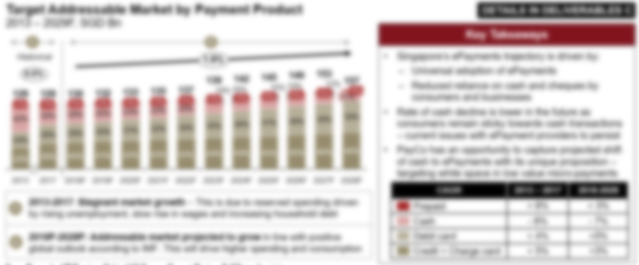
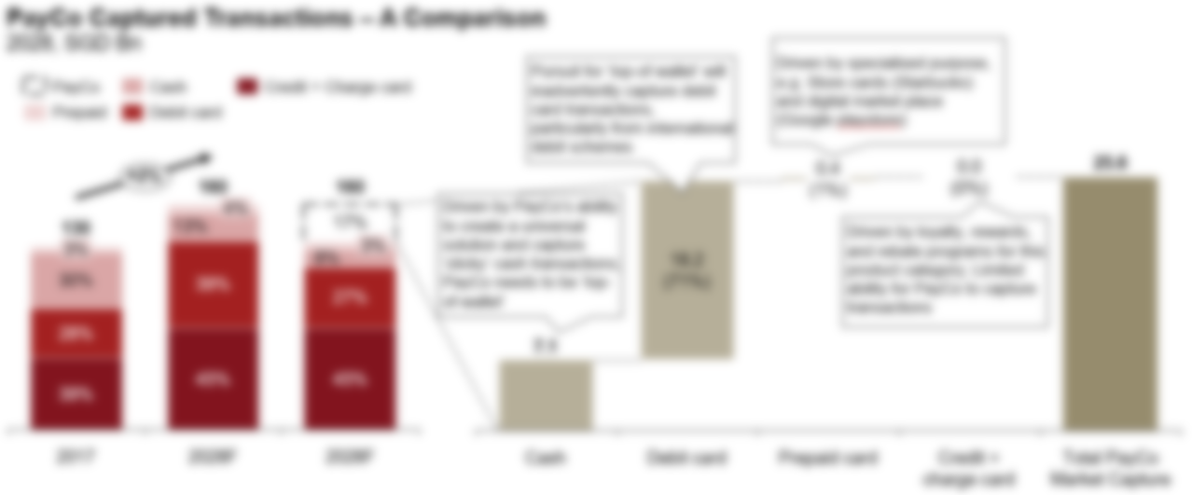
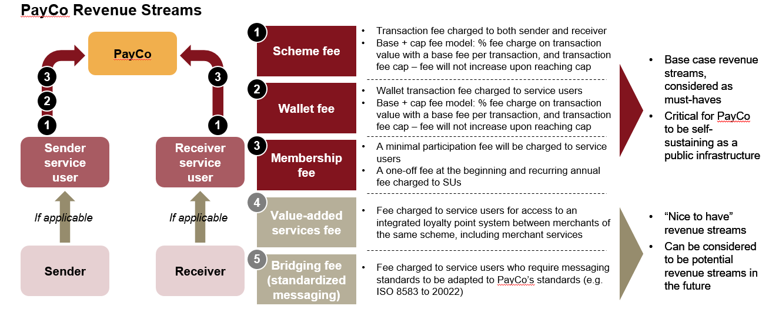
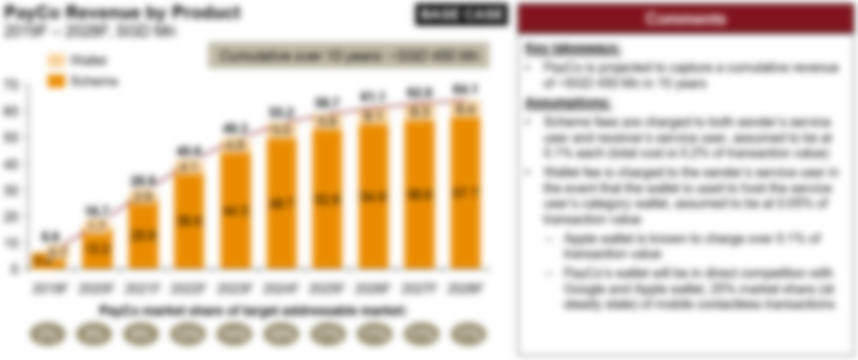
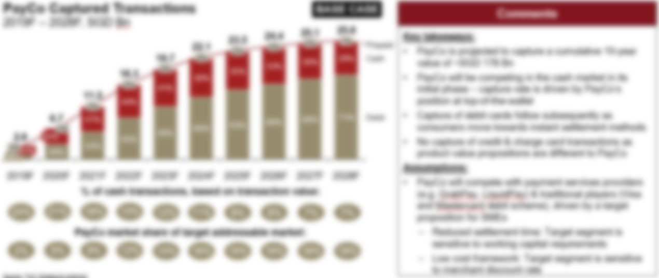

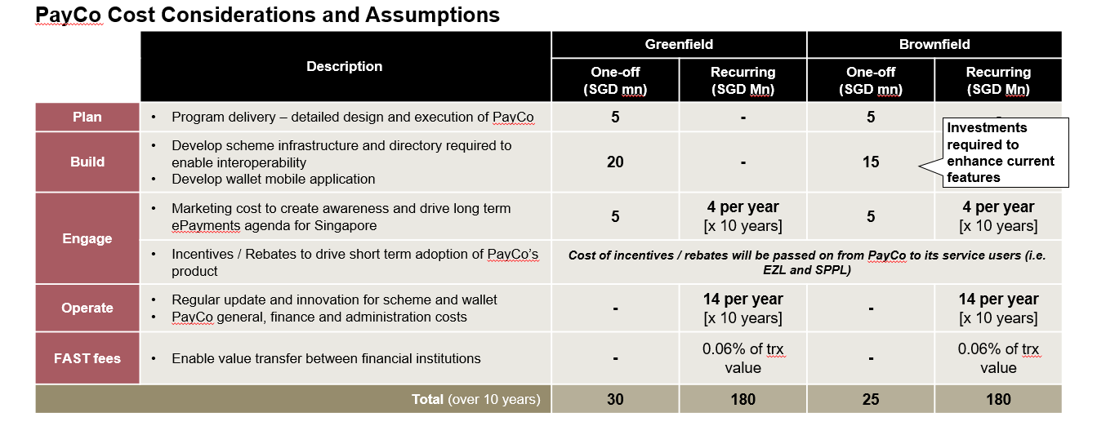
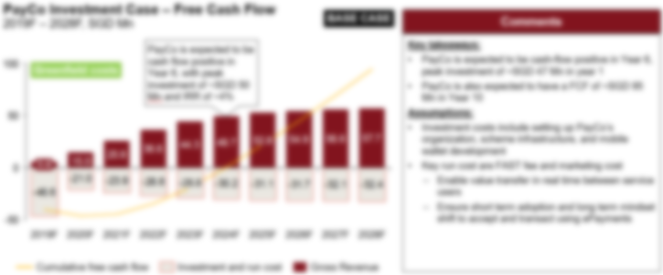
The target addressable market for NewCo was identified and business case developed to substantiate the investment required
Overview of the Target Addressable Market
Overview of the Business Case
Key Takeaways
NewCo will be competing in the informal cash market in its initial phase – capture rate is driven by NewCo’s interoperability feature and it’s position at top-of-the-wallet
NewCo will capture debit card transactions subsequently as consumers move away from delayed to instant settlement of funds
Credit and charge card transactions will not be captured by NewCo as they offer consumers a different product proposition to NewCo, competing in a different market
Key Takeaways
As a national infrastructure, NewCo’s fees to service users will be lower than local and international ePayment players – main revenue lines include the wallet, scheme and membership fee
NewCo Wallet will be in direct competition with Google, Samsung and Apple wallet at steady state
NewCo’s costs buckets are categorised into Plan, Build, Engage, Operate and Change – largest in Build as capital is required develop the scheme infrastructure and directory required to enable interoperability

Slide 20
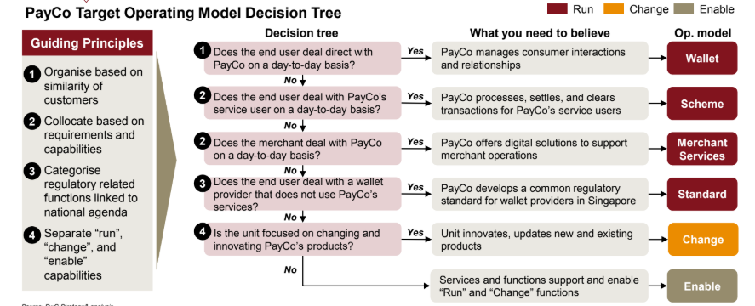
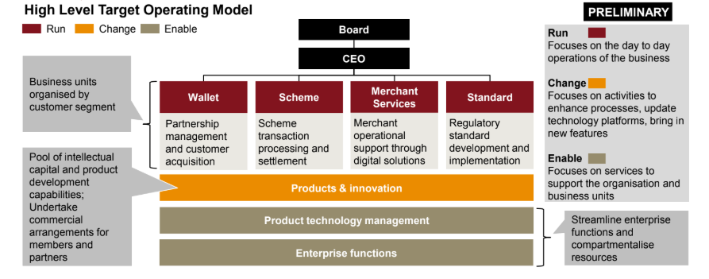
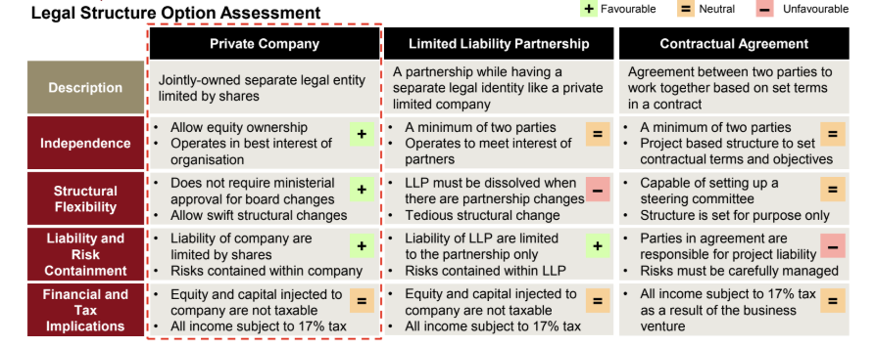
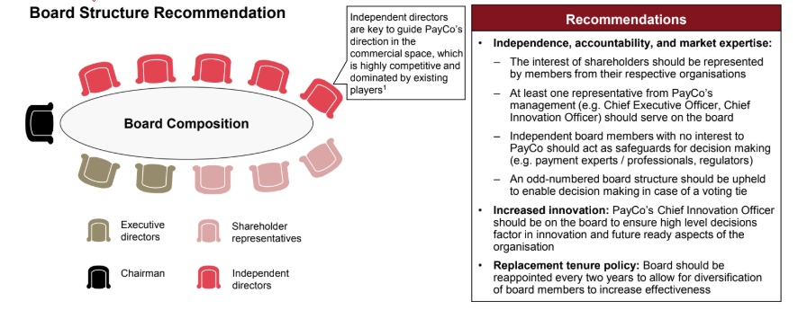
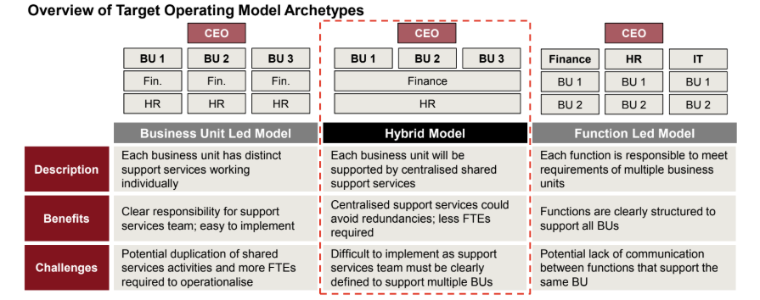
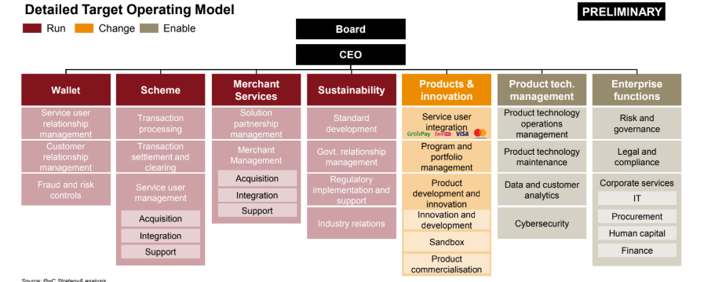
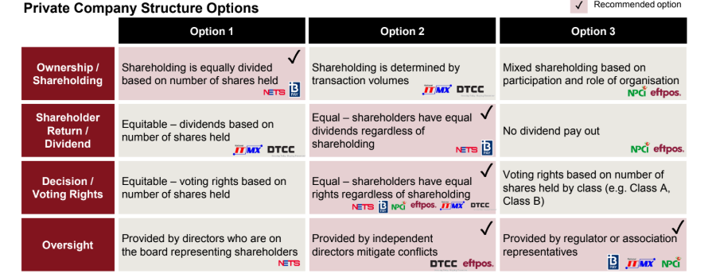
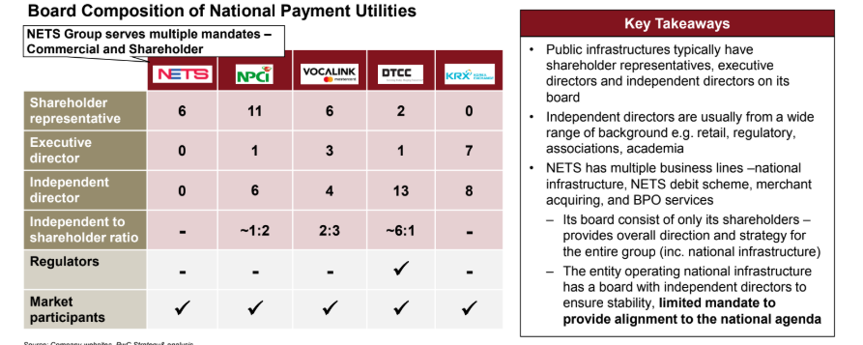
NewCo’s operating model and corporate structure were developed in order to maximise synergies between the Clients
Overview of the Operating Model
Overview of the Corporate Structure
Key Takeaways
A hybrid (cross) model of a Business Unit-led and Functions-led operating model is recommended for NewCo as support services are centralized and redundancies are avoided
NewCo’s target operating model is aimed to be lean and equipped with essential “run” function for NewCo’s service offering, “change” function for products and innovation , and “enable” function for product technology management and enterprise functions
Key Takeaways
NewCo is recommended to be a private company as it allows for independence, swift changes without ministerial approvals, and limited risks for NewCo
As a public infrastructure, NewCo’s Board of Directors will include a chairman, executive directors, shareholder representatives and independent board members from various backgrounds to uphold unbiased decision making

Slide 21
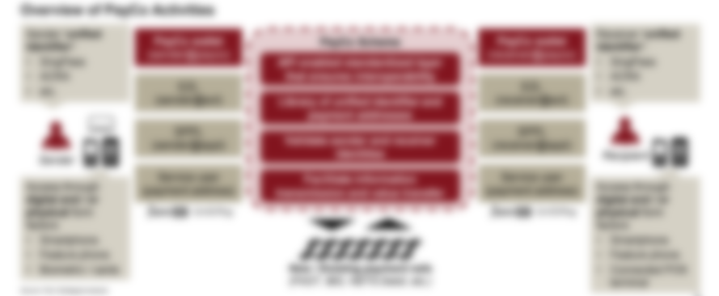
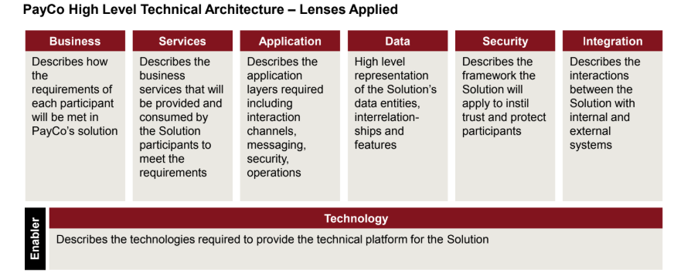
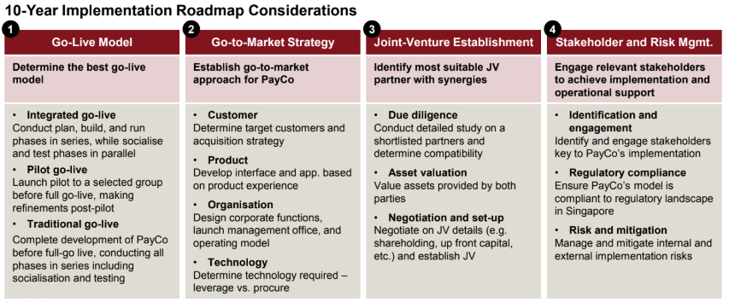
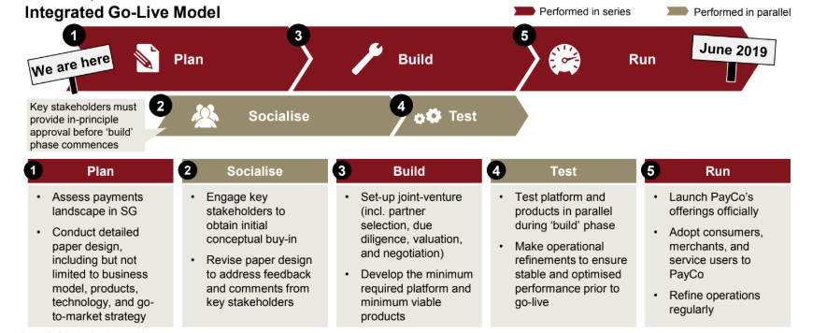
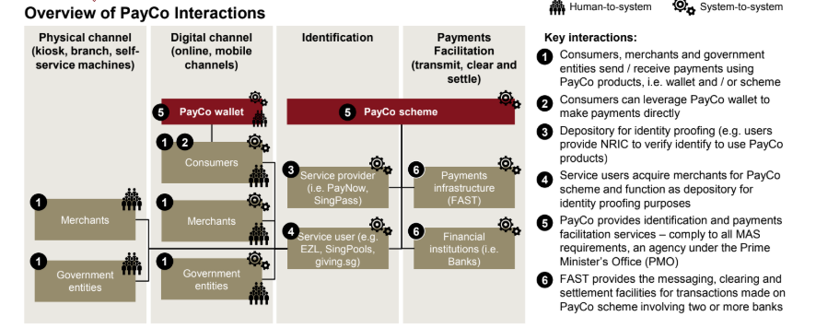
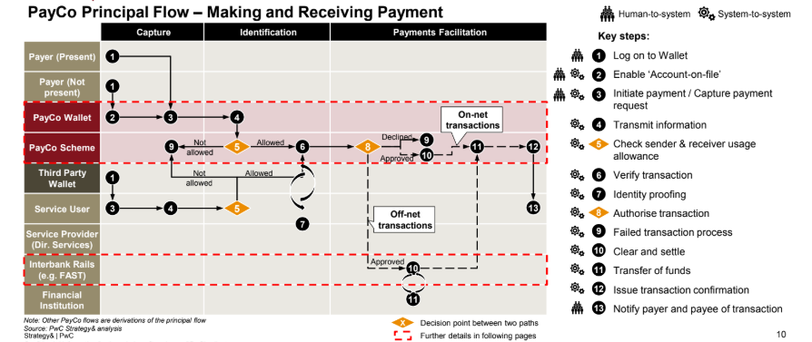
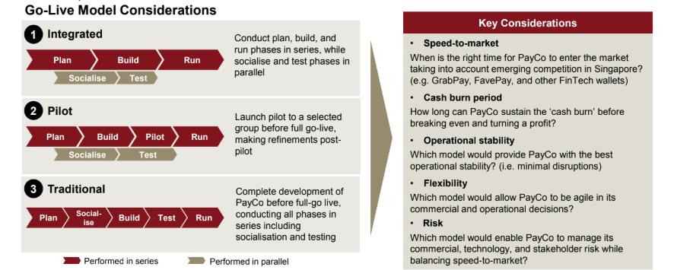
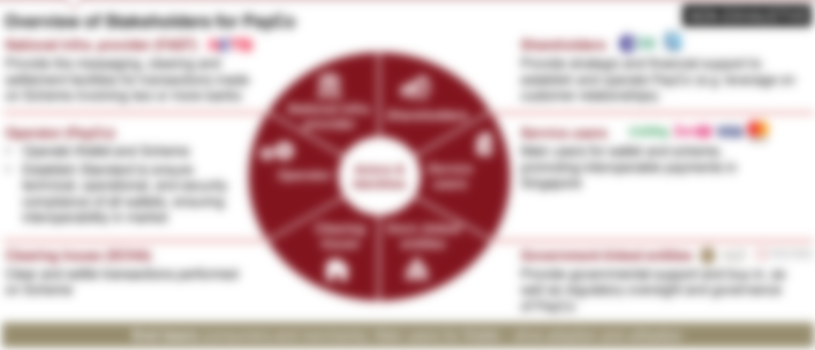
The high level technical architecture and implementation roadmap were developed to aid implementation of NewCo
Overview of the Technical Architecture
Overview of the Implementation Roadmap
Key Takeaways
NewCo services to include capturing payment request, transmitting messages, and verifying and authorising transactions to facilitating clearing and settlement
To capture payment requests, NewCo will leverage on existing channels (i.e. QR code) and greenfield (i.e. biometrics) in order to maximise affordability, availability, scalability and security
NewCo will provide a seamless payments experience which includes human-to-system and system-to-system interaction
Key Takeaways
As a public infrastructure, an integrated go-live model was recommended for NewCo as stakeholder socialisation and testing runs in parallel with the traditional plan, build and run
Go-live for NewCo will be fast-to-market, potentially ahead of emerging FinTech competition
Flexibility in making operational refinements
Support from key stakeholders in the early stages is crucial to ensure the success of NewCo

Slide 22

Strategy Impact
© 2018 PwC. All rights reserved.
PwC refers to the PwC network and/or one or more of its member firms, each of which is a separate legal entity. Please see www.pwc.com/structure for further details.

